Slide 1

Intro to Computer Science
DEMI G4S1-Lesson 3–Sprites in Action (Events).
الجلسة التطبيقية: الثالثة
المستوى: الأول

Slide 2
World Problems
DEMI G4S3 - Lesson 1 – Health App

Slide 4
1
Learn
Learn about the different world problems
Go through the phases of ideation and brainstorm software ideas to solve a certain problem
Draw an outline to illustrate the application idea
Make
Get and Develop a mobile app idea that talks about (health care)
Share
Present the work done through the session and the learned topics

Slide 5
Learn &
Have you ever used a mobile app to learn something new or to solve a problem?

Slide 6
Do you think that we can use mobile apps to help solving world problems?

Slide 7
There are a lot of common world problems, like Health and Hunger.

Slide 8

During this session we are going to learn more about the Health Care ….

Slide 9
Do you know any ways we can take care of ourselves to stay healthy?

Slide 10
How could we use mobile apps to solve health problems?.. lets’ see

Slide 11
Mobile apps can help people take care of their health..
for example..

Slide 12
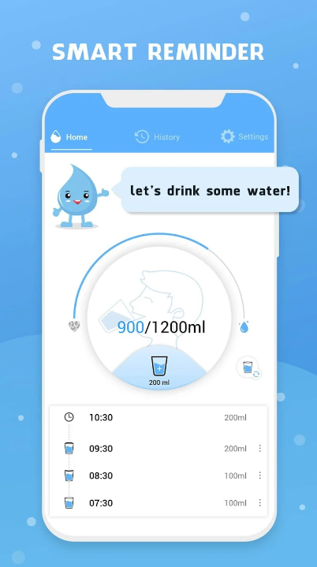
Drinking water reminder App

Slide 13
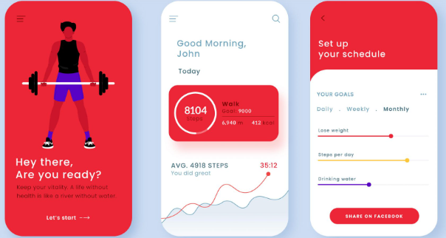
Fitness App

Slide 14
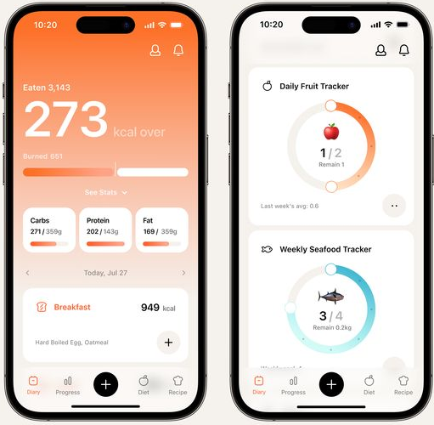
Calories Counter App

Slide 15

Now we will start searching for our idea

Slide 16
Before you use google you need to know how to use it correctly.
Do not copy others work
Use trusted references: for example links that ends with .org or . edu
Use accurate related words in your search
Notes:
In this slide, you need to mention:
Students should not copy others work
They should use trusted references: for example links that ends with .org or . edu
use accurate related words in your search

Slide 17
You have 10 minutes to work with your group to find an application idea for people health…
Hint: Use google to get inspired from similar applications

Slide 18

15 دقائق

Slide 20
Design and Code pages of your application idea (On App lab):
It should include:
Sign up page
Login page
Home page
Notes:
(App lab)

Slide 21
let’s see how to present our app

Slide 22

Presentation Skills
https://youtu.be/8IbheB2-ixM?si=_RslQfJyWng1fy5u

Slide 23
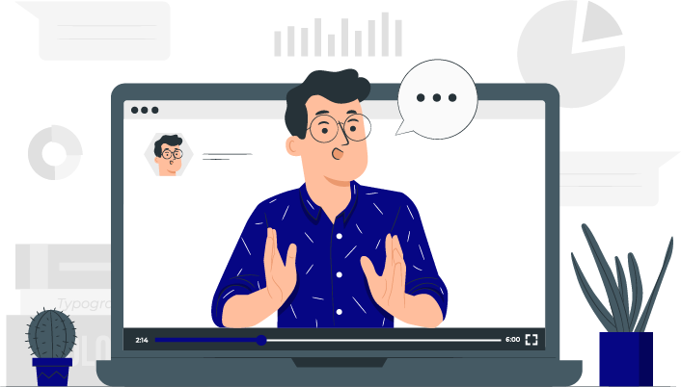
Each group will have
3 minutes to present their app and how they built it

Slide 24
Conditional Cards
Notes:
https://drive.google.com/file/d/1XT7KjX9bujTHN-7N916oZa4Xa0208hmm/view?usp=sharing

Slide 27
Learn about the different world problems
Go through the phases of ideation and brainstorm software ideas to solve a certain problem
Draw an outline to illustrate the application idea
Determine all the features to be included in the application
Draw flowcharts that define the user interactivity across the application

Slide 29


